Slide 1
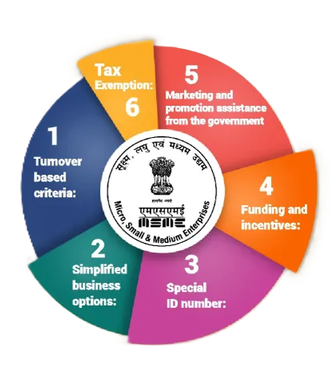

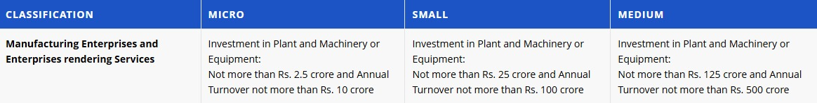
What is MSME?
MSME = Micro, Small & Medium Enterprises
Definition: Businesses that operate on a smaller scale with limited investment in plant, machinery, and annual turnover.
MSMEs in Numbers:
📊 63 million+ MSMEs in India 👥 110 million+ people employed (2nd largest employer
after agriculture) 💰 30% of India's GDP 🌍 45% of India's total exports
Classification in India

Slide 2
Problem Identified
After analyzing the current working methods of MSMEs and the limitations of existing digital tools, several key problems were identified:
Manual Record Keeping: Many small businesses still maintain records using notebooks or basic spreadsheets, which can lead to errors and data loss.
Lack of Digital Knowledge: Most MSME owners do not have technical skills to use complex software or build digital systems for their businesses
High Cost of Software: Many advanced business management tools are expensive and difficult for small businesses to afford.
Limited Customization: Existing solutions provide fixed features, making it difficult for businesses to adapt the software to their specific needs.
Multiple Tools for Different Tasks: Businesses often need separate tools for billing, inventory, and customer management, which makes the process complicated and inefficient.
Poor Data Insights: Without proper digital tools, business owners cannot easily analyze sales, inventory trends, or customer behavior.

Slide 3

Existing Solution/ Survey
Existing Solutions
Several digital tools are already available to help businesses manage operations such as accounting, billing, inventory management, and customer records. Many MSMEs use software like TallyPrime, Zoho Books, Vyapar, and ERPNext.
These platforms help automate tasks such as:
Invoice generation and billing
Inventory tracking
GST and financial record management
Sales and purchase reporting
Such tools help businesses reduce manual work and maintain better financial records. Some cloud-based solutions also allow access from multiple devices and provide basic analytics for monitoring business performance.

Slide 4
Existing Solution/ Survey
Comparison Between TaskMint vs Tally vs Zoho Books
Feature | TaskMint (Your App) | Tally | Zoho Books
Target Users | Micro & Small MSMEs | Accountants, medium businesses | Small & growing businesses
Platform Type | Low-code, customizable app | Desktop software | Cloud-based SaaS
Ease of Use | Simple UI for non-technical users | Requires accounting knowledge | Moderate learning curve
Order Tracking | ✅ Real-time & integrated | ❌ Limited | ⚠️ Basic
Inventory Management | ✅ Simple + Visual | ✅ Advanced | ✅ Advanced
Invoicing & GST | ✅ Basic GST billing | ✅ Strong GST support | ✅ Strong GST support
Customer Follow-up | ✅ Built-in reminders & CRM-lite | ❌ Not focused | ⚠️ Limited CRM
Analytics Dashboard | ✅ Simple visual insights | ⚠️ Accounting reports | ✅ Detailed financial reports
Customization | ✅ Easily customizable (Low-code) | ❌ Limited | ⚠️ Limited to settings
Cost | Affordable for micro businesses | Moderate | Monthly subscription
IT Knowledge Required | ❌ No | ⚠️ Yes | ⚠️ Basic

Slide 5
Proposed Solution
To develop a simple and affordable low-code platform that helps Micro, Small and Medium Enterprises (MSMEs) to create and manage their own business applications such as billing, inventory, employee records, and customer management without any need of programming skills.
🎯 MSME-First Design
• Simple interface for users with low digital literacy
• Regional language support (future scope)
• Minimal training required
🔄 All-in-One Integration
• Orders + Inventory + Invoicing + Payments in single platform
• No need for multiple apps or tools
• Seamless data flow between modules
Digital Adoption
Affordability
Scalability
Drag-and-Drop Components
⚡ Smart Automation
• Auto stock deduction logic
• Automatic GST calculations
• Intelligent follow-up reminders
💰 Affordable & Accessible
• Low-cost alternative to traditional ERPs
• No expensive hardware (POS machines) required
• Works on basic smartphones
Real-time Insights
Data Management
Paperwork Reduction
Goals of the Low-Code Platform

Slide 6

Novelty / Innovation
Innovative Aspects
Low-Code Application Builder designed specifically for MSMEs
Drag-and-Drop Modules for quick and easy app creation
Single Platform for Multiple Business Functions
Customizable Workflows based on business needs
Affordable and easy to adopt for small businesses
Cloud-based system enabling real-time access and data management
MSME Builder introduces a simple low-code platform designed to help small businesses easily adopt digital tools without requiring programming knowledge. The platform simplifies the process of creating and managing business applications, making technology more accessible and practical for MSME owners. By focusing on ease of use and accessibility, the solution supports faster digital adoption and improves overall business efficiency.

Slide 7
Block Diagram
How It Works
Step 1: Order Received → Customer places order via phone/WhatsApp/walk-in → Seller enters order details in app
Step 2: Auto Processing → Inventory automatically updated
→ Stock deducted from available quantity
→ Low-stock alert triggered if needed
Step 3: Invoice & Payment
→ GST invoice auto-generated (PDF)
Step 4: Analytics & Follow-up
→ Sales data updated in dashboard
→ Customer added to follow-up list
→ Business insights refreshed

Slide 8
Technology Stack / Methodology
Methodology
The proposed MSME Builder platform will be implemented as a cloud-based low-code web application designed to simplify digital adoption for small businesses. The system will consist of a user-friendly frontend interface where MSME owners can access the platform through a web browser or mobile device. After logging in, users will be able to create business applications using a drag-and-drop builder that provides ready-made modules such as billing, inventory management, customer records, and order tracking.
The frontend will handle user interaction and display dashboards, while the backend server will process requests, manage application logic, and store data securely in a cloud database. The platform will automatically generate customized workflows based on the modules selected by the user. This allows businesses to quickly build and manage their digital tools without writing any code.
The system will also include an analytics dashboard that provides insights such as sales reports, stock levels, and customer activity, helping business owners make better decisions. By using cloud technology, the platform ensures scalability, data security, and easy access from multiple devices. This implementation approach makes the system simple, cost-effective, and practical for MSMEs to adopt.

Slide 9
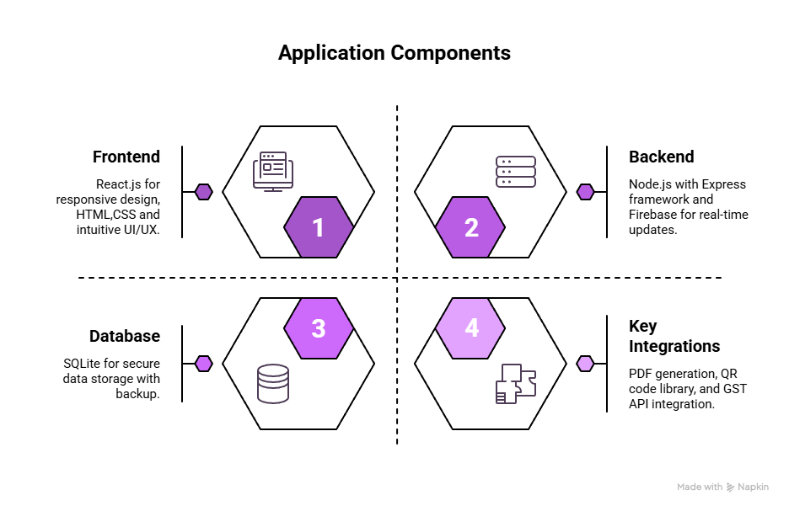

Technology Stack / Methodology
Technical Aspects
Frontend Technologies
React.js (Mobile-First Responsive Design)
Component-based architecture
Fast rendering with Virtual DOM
Fully responsive design for mobile, tablet & desktop
Scalable and reusable UI components
HTML
Structured and semantic web layout
Improved accessibility
Cross-browser compatibility
Intuitive UI/UX for Non-Technical Users
Simple dashboard interface
Clear navigation menus
Minimal training required
Local language support (optional feature)
Guided workflows for invoicing & order tracking

Slide 10
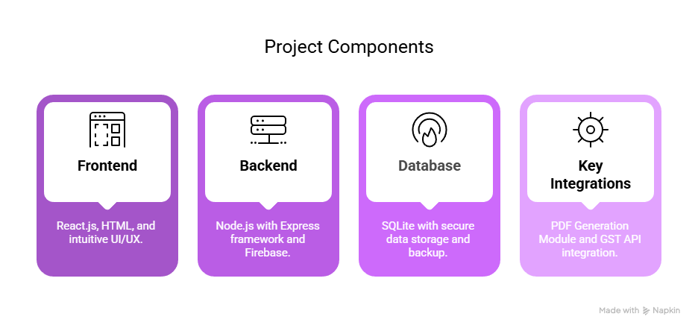
Technology Stack / Methodology
Database
SQLite
Lightweight relational database
Ideal for small to medium-scale businesses
Easy deployment
Low maintenance
Secure Data Storage with Backup
Encrypted data storage
Regular automated backups
Role-based access control
Protection against data loss
Key Integrations
📄 PDF Generation Module (Invoice Creation)
Auto-generate GST-compliant invoices
Download & share invoice as PDF
Customizable invoice template
🧾 GST API Integration (Tax Calculations)
Automatic GST calculation
HSN/SAC code integration
Tax report generation
Reduces manual tax errors\

Slide 11
Technology Stack / Methodology
Development Cost
One-Time Development Cost (MVP)
Cloud Monthly Running Cost (Startup Scale)
Component | Cost (INR)
Backend (FastAPI, DB, APIs) | ₹60,000
Frontend (Web dashboard / Streamlit / React) | ₹40,000
UI/UX Design | ₹20,000
Testing & Bug Fixing | ₹20,000
Item | Cost / Month
Backend Server (AWS/GCP/Azure) | ₹4,000
GPU Server for AI Inference | ₹7,000
Database (MongoDB Atlas / PostgreSQL) | ₹3,000
Image Storage (S3 / Cloudinary) | ₹2,000
APIs (SerpAPI, Email, PDF, etc.) | ₹2,000
Monitoring & Logs | ₹1,000
Total One-Time Build Cost (Startup MVP)
₹140,000 (approx.)
(If done by a small team / freelancers / founders)
Total Monthly Infra Cost
₹19,000/ month

Slide 12

Impacts
Expected Impact
Quantifiable Benefits:
📉 Error Reduction:
• Zero stock mismatches
• Accurate GST calculations
• No missing invoices
💡 Digital Adoption:
• Brings MSMEs into formal economy
• Enables GST compliance
• Supports Digital India initiative
📈 Business Growth:
• 40% improvement in customer retention
• Better cash flow with digital payments
• Data-driven decision making
Social Impact:
✓ Empowers rural entrepreneurs
✓ Supports women-led home businesses
✓ Promotes financial inclusion
⏱️ Time Savings:
• 10-15 hours/week saved on manual bookkeeping
• 80% faster invoice generation
• Instant payment collection

Slide 13

Impacts
Future Scope
🌐 Multi-Language Support
• Hindi, Tamil, Telugu, Bengali, Marathi
• Voice-based data entry
📱 WhatsApp Integration
• Automated order confirmations
• Invoice sharing via WhatsApp
• Payment links
🤖 AI-Powered Features
• Demand prediction
• Smart inventory recommendations
• Customer behavior analytics

Slide 14

Impacts
📋 GST Filing Integration
• Direct GST return filing
• Automated tax reports
• CA/Accountant portal
🏪 Multi-Store Support
• Manage multiple locations
• Centralized inventory
• Staff access controls
💳 Credit & Lending
• Integration with NBFCs
• Business loan eligibility based on data
• Working capital solutions

Slide 15

Conclusion
Conclusion
Live Demo Highlights:
Create Order - 30 seconds
Auto Inventory Update - Instant
Generate GST Invoice - 1 click
Show QR Payment - Customer scans
View Analytics - Real-time dashboard
Key Takeaways:
✅ Solves real pain points for 63M MSMEs
✅ Simple, affordable, mobile-first solution
✅ Complete digitization in one platform
✅ GST-compliant & payment-ready
✅ Scalable technology architecture
Our Vision: "Empowering every small business in India with enterprise-grade tools at zero complexity"

Slide 16


